Slide 1
OTC Market Presentation
Group 1: Daria Khotunitskaya, Gregory Sycle, Matthew Richards, Daniel Tlaxcaltecatl, Alyssa Iglesias

Slide 2
Project Goal & Importance
Can we use data to profit from OTC Market?
If yes, how much?
We developed a product using technical analysis.

Slide 3
Requirement Details
Business
Data
Functional
Evaluate Profitability
Handle Volume/
Historical Data
Generate actionable trading insight

Slide 4
Requirement Details (cont’d)
Technical
Regulatory
Clean, transform, prepare and analyze data
Comply to regulations and laws

Slide 5
Business Personas
Traders/Investors
Portfolio Managers and Financial Advisors
Risk Managers
Data Scientists and Engineers

Slide 6
Benefits and Costs
Benefits
Costs
Competitive Advantage
Operational Efficiency
Confident Trades
Developmental
Maintenance
Infrastructure

Slide 7
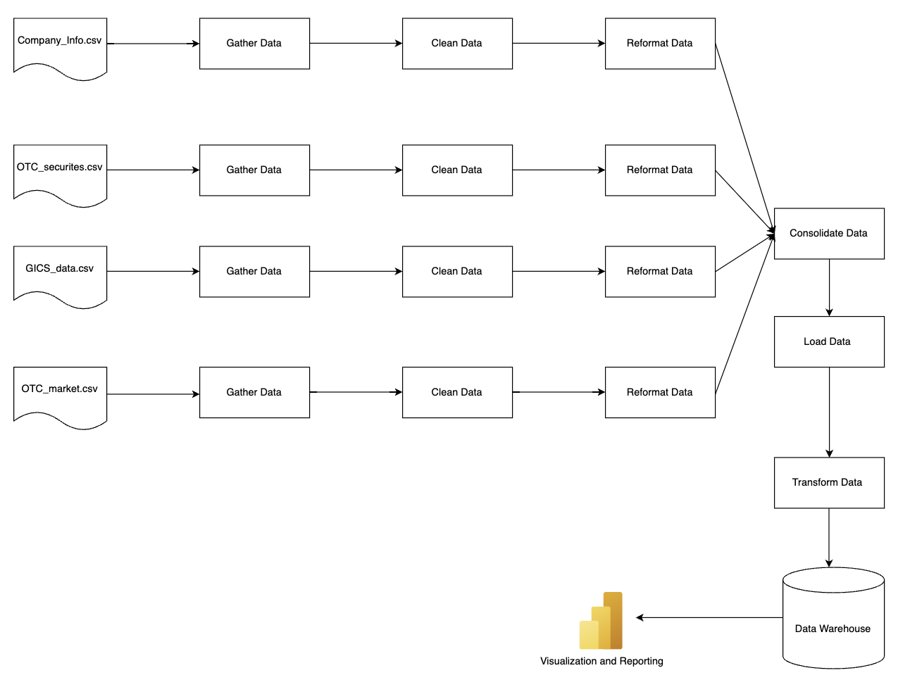
Information Architecture

Slide 8
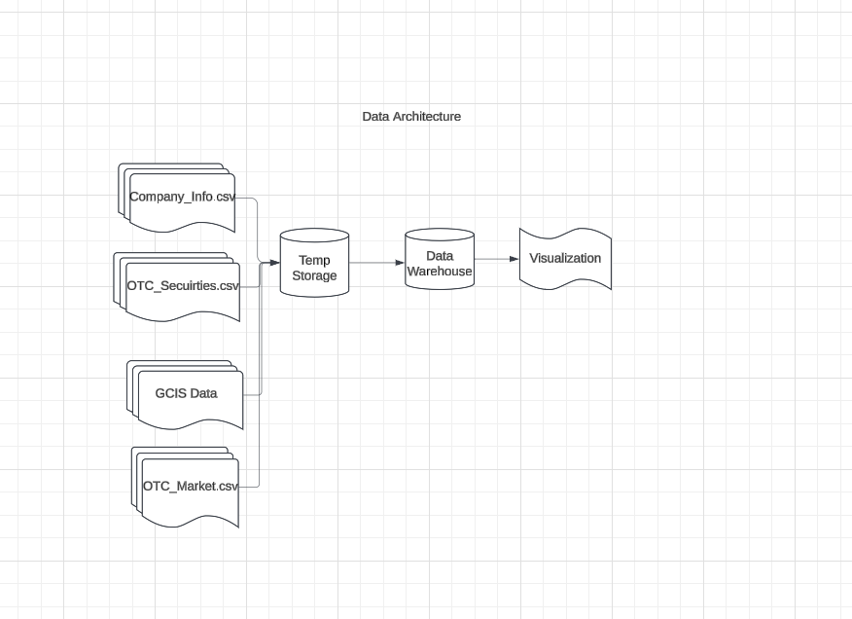
Data Architecture
Notes:
Greg

Slide 9
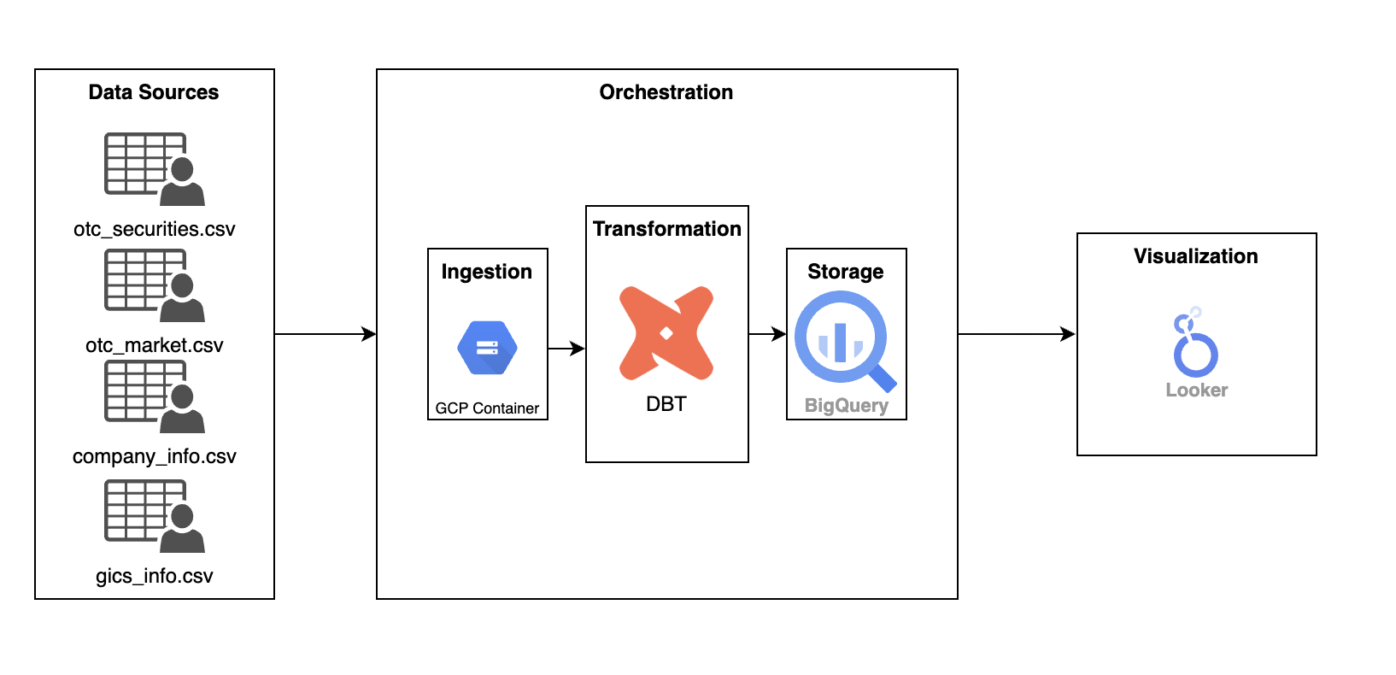
Technical Architecture
Notes:
Greg

Slide 10
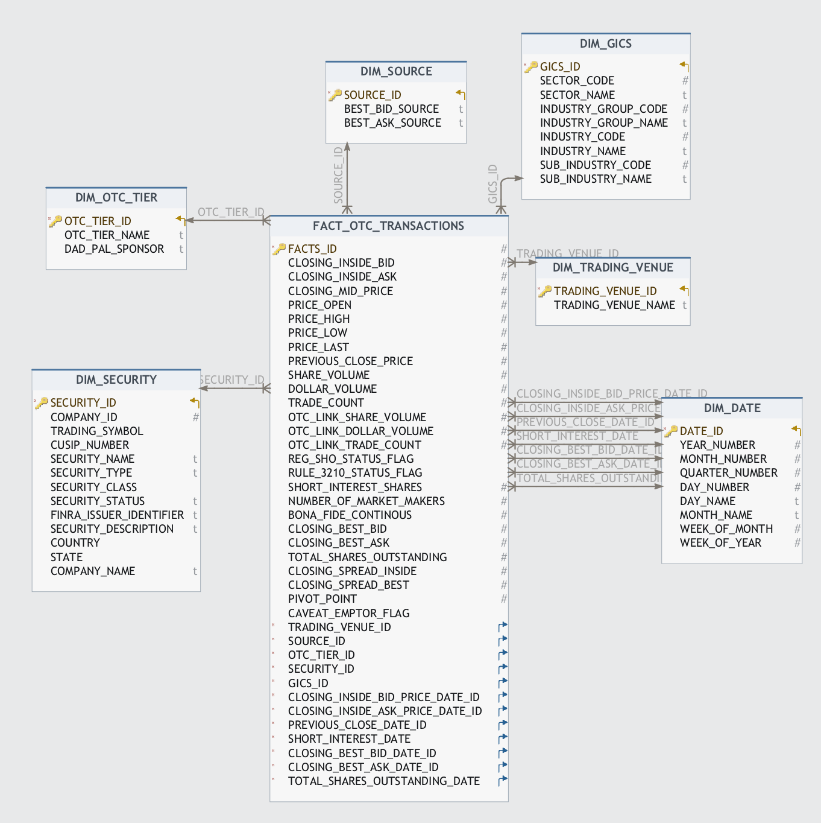
Dimensional Model
Notes:
Greg

Slide 11
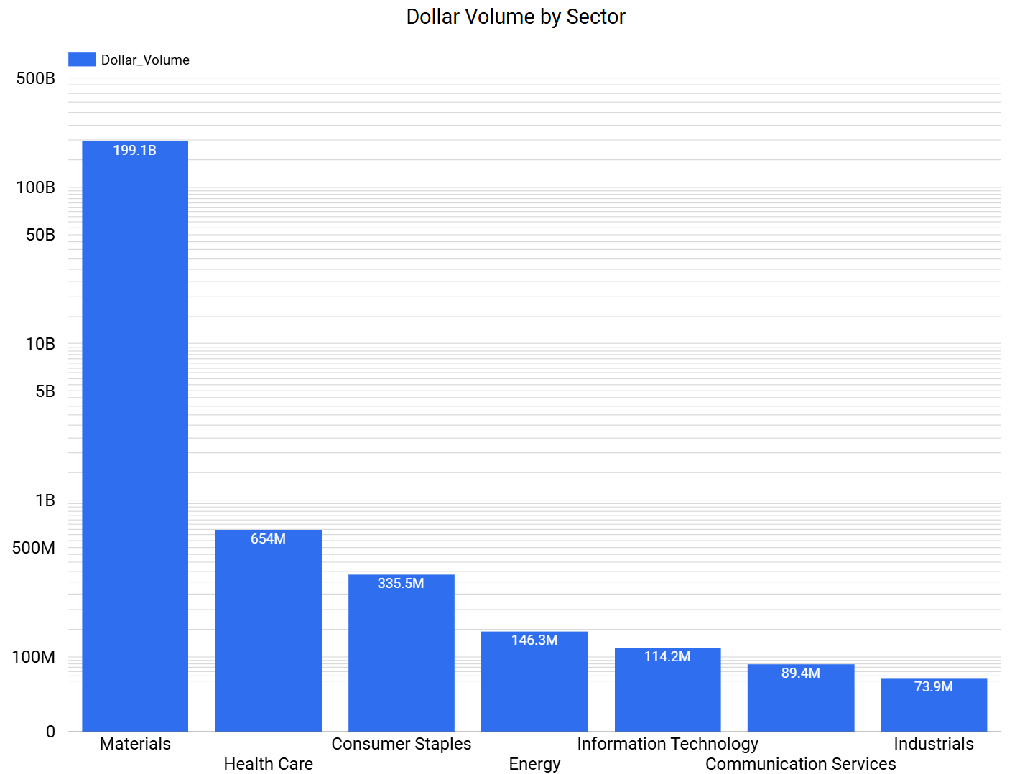

Slide 12
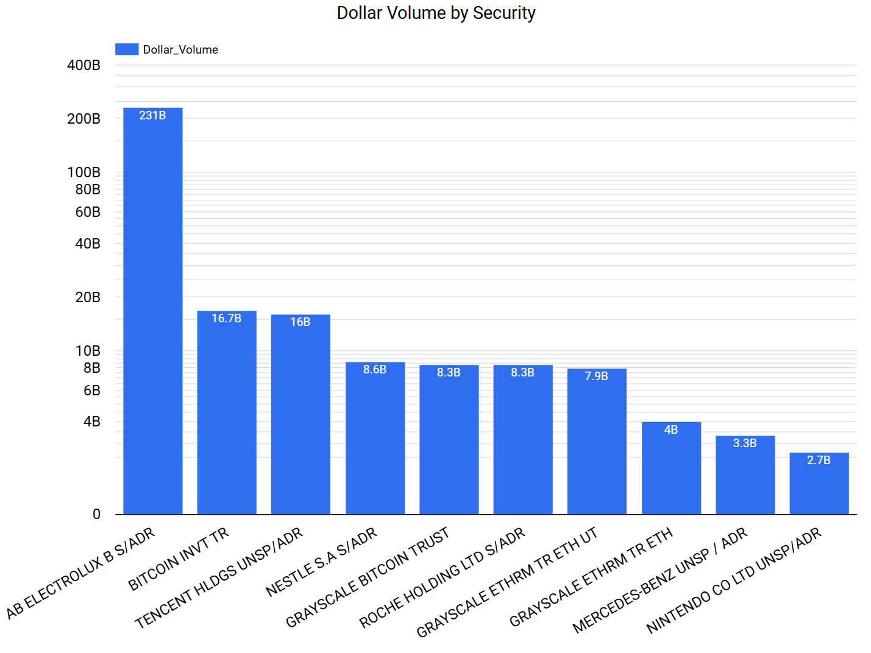

Slide 13
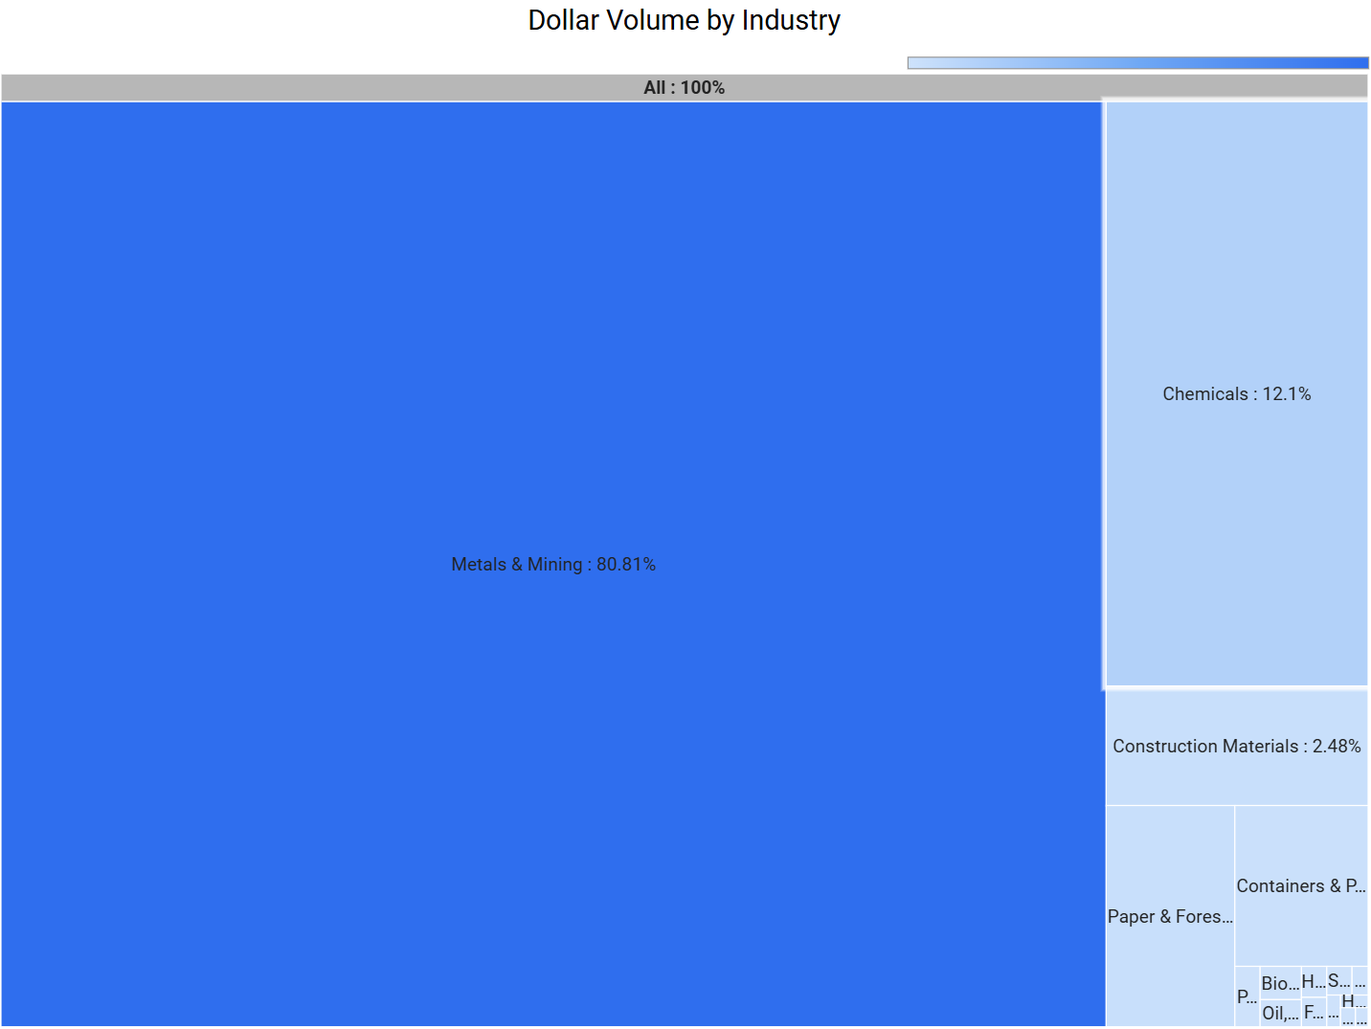

Slide 14
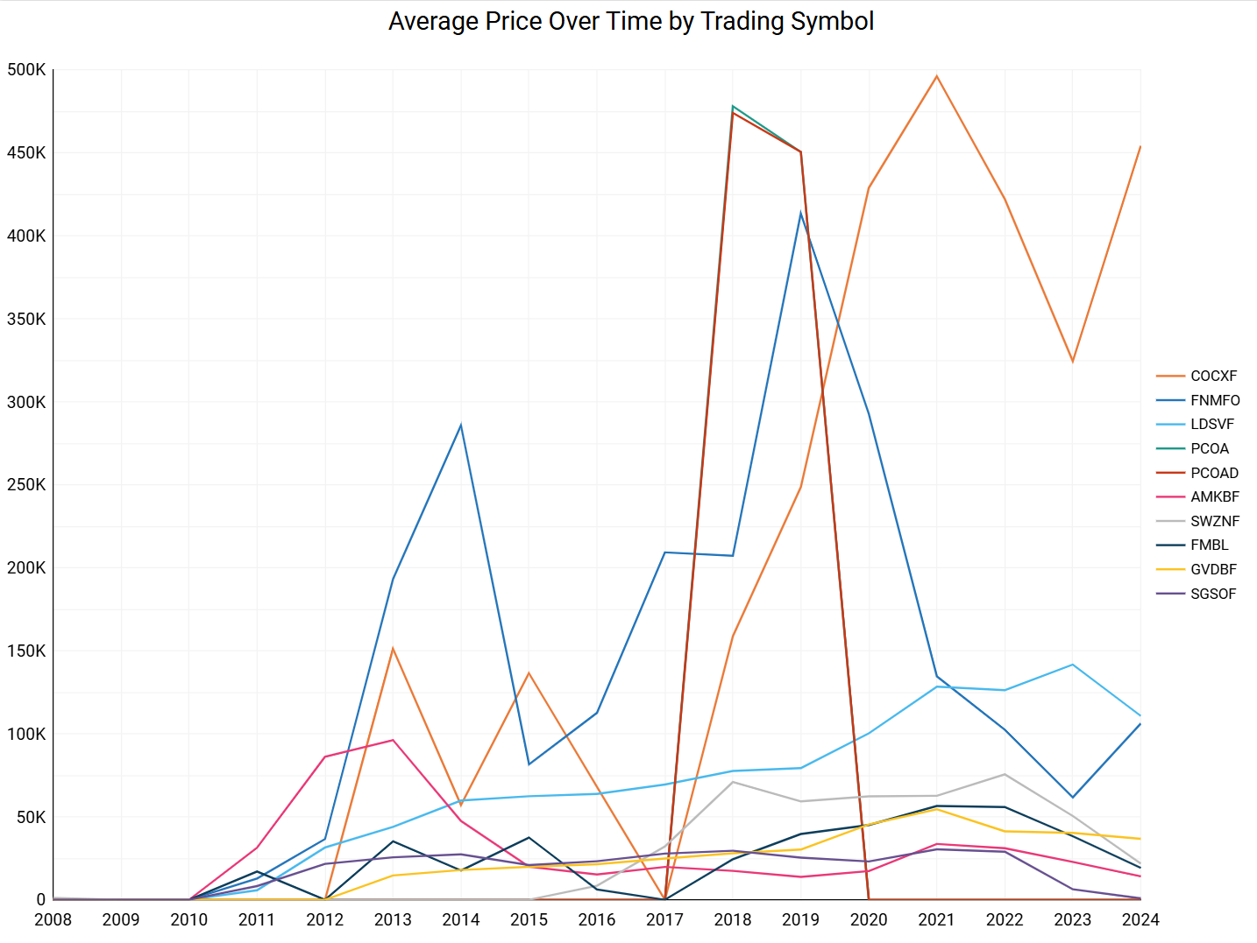

Slide 15
Conclusion
Trends in:
Stocks
Countries
Prices (historically)

Slide 16
Future Work
Incorporating a deep learning model
Notes:
to provide information for technical analysis and OTC market growth for security

Slide 17
Matthew Richards
Gregory Sycle
Alyssa Iglesias
Daria Khotunitskaya
Daniel Tlaxcaltecatl
Member Contribution
Data Modeling
ELT
Built Data Dictionary and Mapping
1. Data Dashboard
2. Data Exploration
Powerpoint
Data Dictionary Assistance
1. ELT
2. Report write-up
3. Built Data Dictionary and Mapping
1. Data Dashboard

Slide 18
Thanks
Daria Khotunitskaya: daria.khotunitskaya@baruchmail.cuny.edu
Gregory Sycle: gregory.sycle@baruchmail.cuny.edu
Matthew Richards: matthew.richards@baruchmail.cuny.edu
Daniel Tlaxcaltecatl: daniel.tlaxcaltecatl@baruchmail.cuny.edu
Alyssa Iglesias: alyssa.iglesias@baruchmail.cuny.edu
Notes:
Interface Explanations along with pictures for that. Diagrams in readMe. Data Pipeline question? Hope to get that answered. Write personal scripts for what you are gonna say.

